Slide 1



Work and play:
Disease spread, social behaviour
and data collection in schools
Dr Jenny Gage, Dr Andrew Conlan, Dr Ken Eames

Slide 2

Modelling the spread of diseases with mathematics
Mathematicians try to find ways to model how diseases spread.
The Standing Disease (an activity in the presentation Epidemics: Introduction) is a simple way to do this …
… but it doesn’t explain why after a rapid rise in infections there is a peak, and then the rate of infection starts to drop.
Deaths
800
600
400
200
5
10
15
20
25
30
Weeks

Slide 3
Modelling the spread of diseases with mathematics
Mathematicians try to find ways to model how diseases spread.
The Standing Disease (an activity in the presentation Epidemics: Introduction) is a simple way to do this …
… but it doesn’t explain why after a rapid rise in infections there is a peak, and then the rate of infection starts to drop.
Deaths
800
600
400
200
5
10
15
20
25
30
Weeks

Slide 4
Reproductive Ratio
R₀
R₀
Definition: Average number of people an infected person infects at the start of an epidemic.

Slide 5
Reproductive Ratio
R₀
R₀
Definition: Average number of people an infected person infects at the start of an epidemic.
What is R₀ for the Standing Disease?

Slide 6

Reproductive Ratio
R₀
R₀
Definition: Average number of people an infected person infects at the start of an epidemic.
R₀ = 2

Slide 7
Reproductive Ratio
R₀
R₀
Definition: Average number of people an infected person infects at the start of an epidemic.
Deaths
R₀ = 2
800
600
400
R₀ = ??
200
Weeks
5
10
15
20
25
30

Slide 8
Reproductive Ratio
R₀
R₀
R₀ is a measure of how quickly an epidemic will take off…

Slide 9
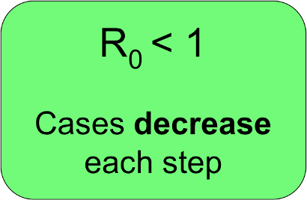
Reproductive Ratio
R₀
R₀
R₀ is a measure of how quickly an epidemic will take off…

Slide 10
Reproductive Ratio
R₀
R₀
R₀ is a measure of how quickly an epidemic will take off…

Slide 11
Reproductive Ratio
R₀
R₀
R₀ is a measure of how quickly an epidemic will take off…
R₀ > 1
Cases increase
each step

Slide 12
Reproductive Ratio
R₀
R₀
R₀ is a measure of how quickly an epidemic will take off…
R₀ > 1
Cases increase
each step

Slide 13
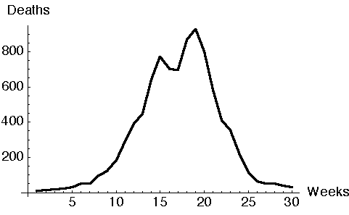
Discussion
So we can understand the start of an outbreak, but what happens next?
Why does the number of cases peak and then decrease?
Is there no one left to infect?
Has the disease changed its nature?

Slide 14
Discussion
So we can understand the start of an outbreak, but what happens next?
Why does the number of cases peak and then decrease?
Is there no one left to infect?
Has the disease changed its nature?
Make a mathematical model
to explore what is happening …

Slide 15
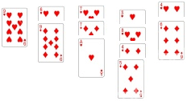
26-Card Epidemic
Put the 26 black cards down in a pile face up.
Put the 26 red cards in a pile face down – this is your population.
Pick one card from this population and put it facing up on the table – this is the first infection (step 0).
It will be red, so replace it with a black card – this represents that person, now recovered and back in the general population.
Shuffle the population cards, and put two cards face up on the table. These are the new infections (step 1).
Put any black cards back into the population pack – these people are now immune, so won’t get the infection again. Replenish the population pack with black cards to replace the red ones you’ve put down.
Repeat items 5 and 6 until you pick only black cards. This is the end of the epidemic, when there are no new infections.
Plot a graph to show how many new infections there are at each step.
Look at the shape of your graph. Does it look at all similar to the one on the right below?
Infections
Step
0
1
2
3
4
Time

Slide 16
26-Card Epidemic
What is the significance of keeping the population at 26?
Any patterns?
  initial steps
  overall shape of graph
  duration
  variability
What is the probability that no one new is infected at step 2?
How might things change if:
  more than one person is infected at the start
  you have more cards
  each infected person infects 3 or 4 people rather than 2
Is this a realistic model?
How could you improve it?
Infections
Step
0
1
2
3
4
Time

Slide 17
Model
Everyone starts here: not yet infected
Susceptible

Slide 18
Model
Everyone starts here: not yet infected
Susceptible
Transmission
These people are unwell and can infect others
Infected

Slide 19
Model
Everyone starts here: not yet infected
Susceptible
Transmission
These people are unwell and can infect others
Infected
Recovery
People recover & become immune to infection
Recovered

Slide 20
Model
Everyone starts here: not yet infected
Susceptible
Transmission
These people are unwell and can infect others
Infected
Recovery
People recover & become immune to infection
Recovered
Need to make assumptions about how people mix together.

Slide 21
The Network Disease
Notes:
Ken

Slide 22
The Network Disease
Like the Standing Disease but:
  - before starting, everyone writes down the names of two other people in the room.
The first case picks the two they’ve written down to infect.
The next generation stands up and each pick their two… and so on.
How is this different from the standing disease?
How many steps to infect everyone?
Notes:
Ken

Slide 23
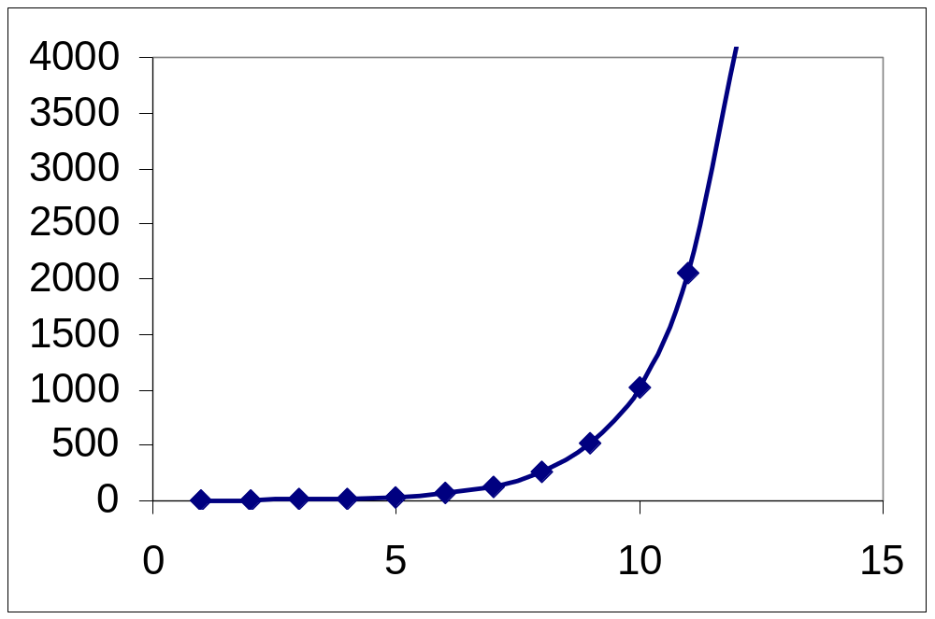

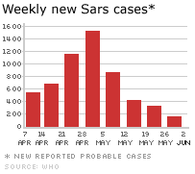
Challenge the models
Are they realistic enough?
What else might be important?
R₀

